Slide 1


ProPay
By: Alex Feng, Adam Graneto, Jonathan Macias

Slide 2
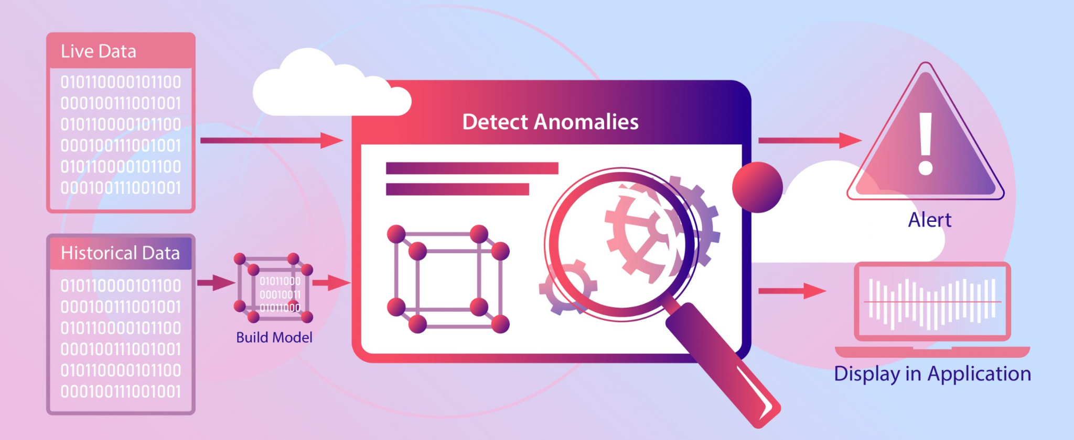
What is it
A real-time credit card processing solution
Intelligent fraud detection

Slide 3


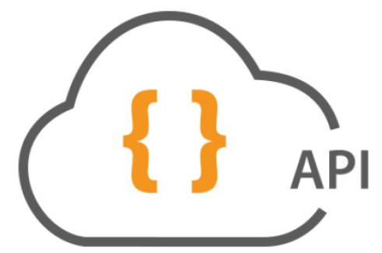


High level architecture
Big data processing
End users submit credit card info from website
API receives data and forwards them to Kafka
Apache Spark performs ETL and fraud detection
Transactions are recorded in Excel csv file
Apache Kafka streams data in and out to to Spark

Slide 4


WebApp & API
Apache Kafka

Slide 5
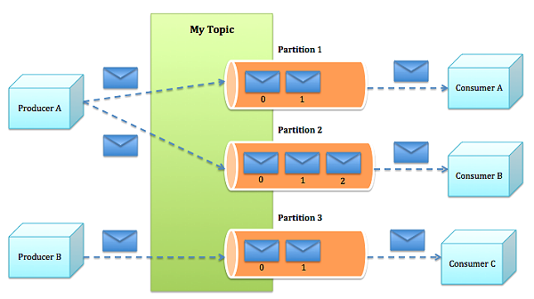
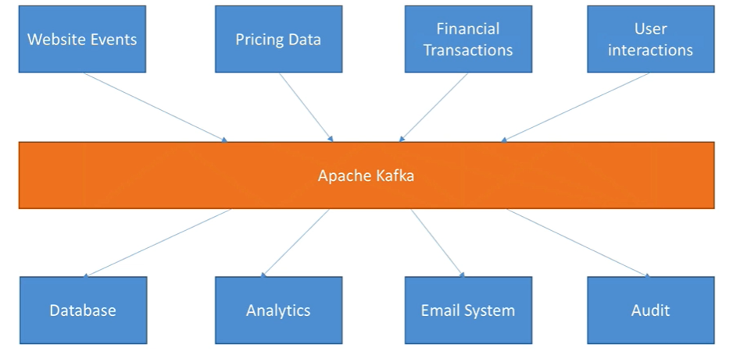
Data streaming with Apache Kafka
Takes many input sources (Producers) and forwards them to many output sources (Consumers)
Producer = generates data
Topic = channel where data is passed through
Divided into multiple Partitions
Consumer = ingests data

Slide 6
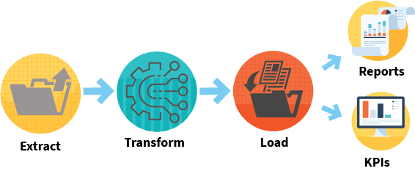
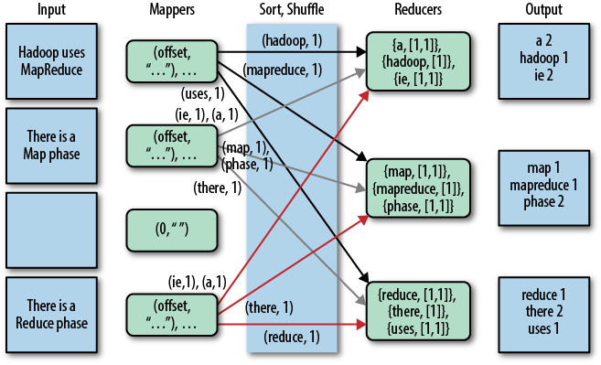
How our Apache Spark application works
Extract, Transform, Load (ETL).
Extract data from Kafka
Transform data by cleaning & formatting it
Data runs through our algorithm to detect fraud
Load results into Excel csv file
Elastic Map Reduce (EMR)
Data processed in parallel via Spark’s clustering capability
Runs processing on multiple servers

Slide 7
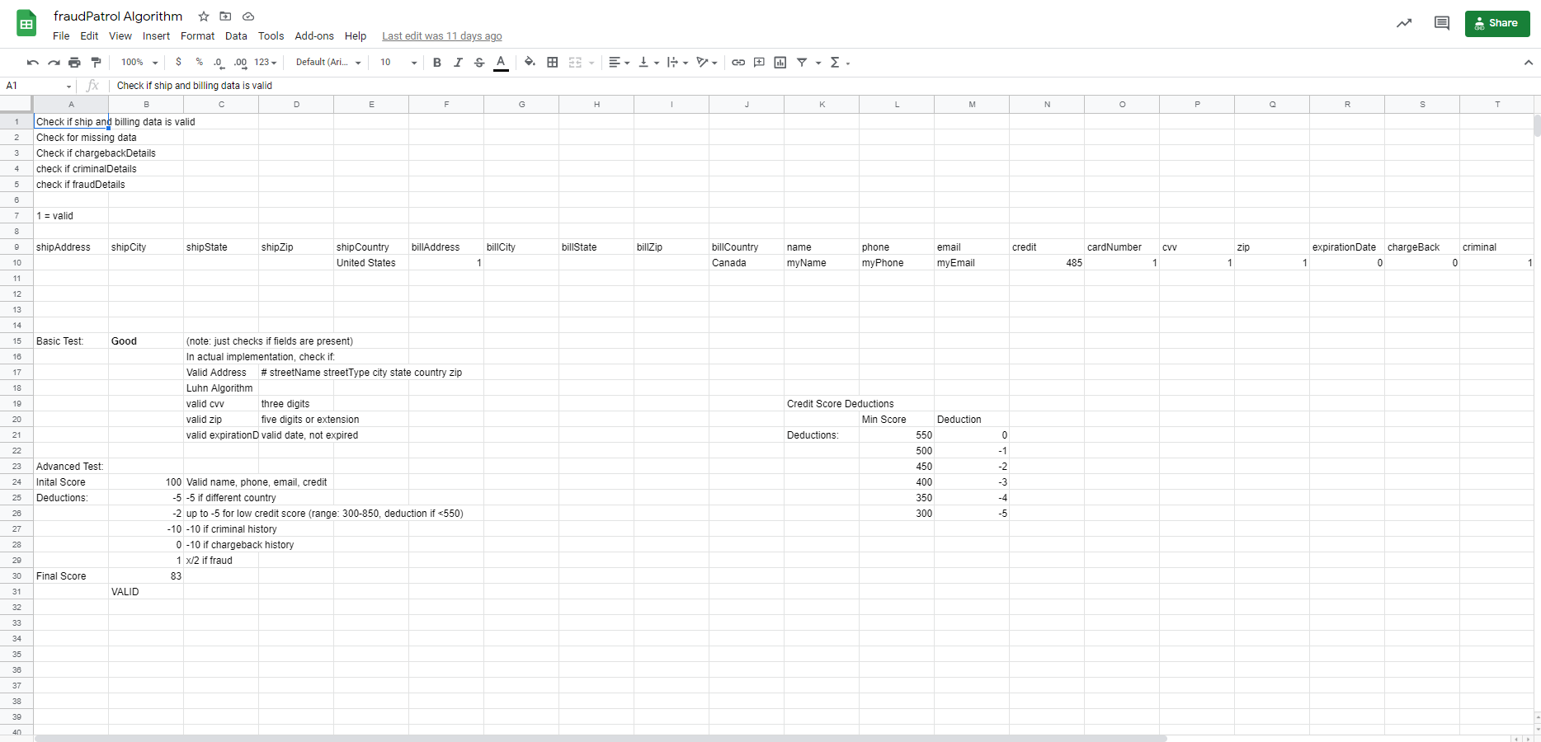
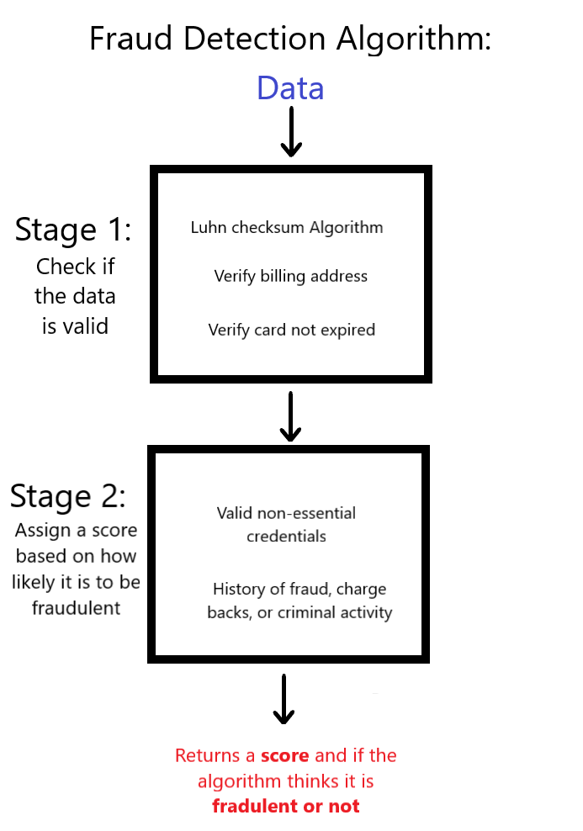
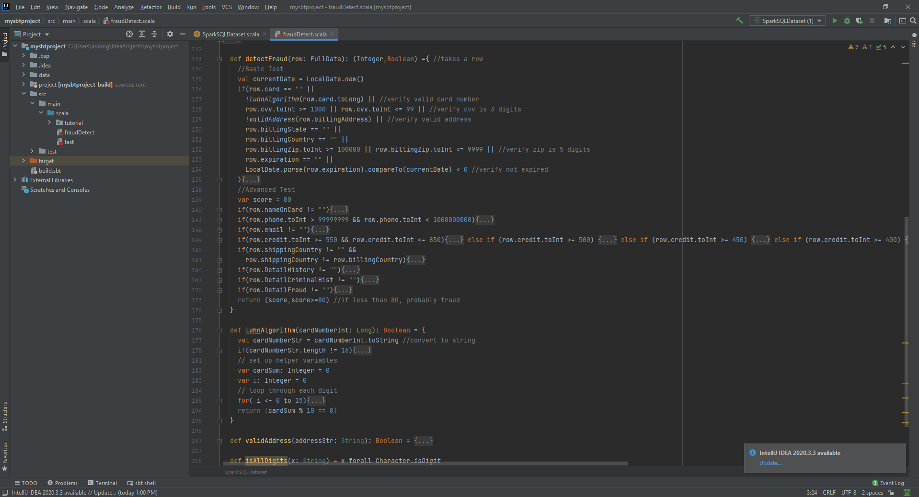
How the Fraud Detection algorithm works

Slide 8
Demo

Slide 9
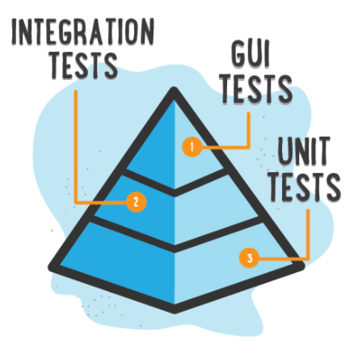

Testing
Unit/Integration tests on Apache Spark application
Manual GUI test on WebApp
JMeter load testing on API

Slide 10
What didn’t go so smoothly
Miscommunication
Alex-Jonathan
Miscommunicate in what the data passing through will look like
Jonathan-Adam
Miscommunication in what the algorithm should do/return
Jonathan-Alex
Miscommunication that data should be placed in csv rather than returned to Alex
Linking the different parts of the project
The type of data that would be passed to and returned by the algorithm
Github Merging
Merging projects was a pain
Moving Spark projects to different directories also caused problem

Slide 11

What went good
Application is fully functional
Website passes data to API
API acts as producer for Kafka
Kafka streams data to the consumer, Spark
Spark performs ETL and identifies fraud
Results are saved to Excel csv
Integration of all our components
Alex worked on
Website
API
Kafka setup
Integration with Spark
Jonathan worked on
Spark ETL
Integration with Algorithm
Integration with Website
Adam worked on
Fraud detection algorithm
Integration with Spark

Slide 12

What we learned
First time using these Big Data technologies
Scala programming language basics
Kafka
How data streaming works
Apache Spark
ETL and EMR
How fraud detection works

Slide 13
The next step
Machine Learning
Replacing the second stage of the algorithm with a learning algorithm that will use training data to compare with inputted data to determine if the transaction is fraudulent or not
Geographic Information Systems
Updating the first stage of the algorithm to use a reference database that the address actually exists rather than follows the proper format
Incorporating the distance between the shipping and billing addresses for determining the fraud score for the transaction

Slide 14

Questions?

